Slide 1
CUSTOMER SERVICE CHATBOT
RNS INSTITUTE OF TECHNOLOGY
BENGALURU - 98
DEPARTMENT OF INFORMATION SCIENCE & ENGINEERING
Presentation on Internship
AMRUTHA S RAO ANAGHA P DIXIT
USN: 1RN19IS024 USN: 1RN19IS026

Slide 2
AGENDA
Abstract
About the Company
Introduction
Literature Survey
Requirements
System Design
Implementation
Results
Conclusion and Future Enhancements
References
Q & A

Slide 3
ABSTRACT
Chatbot can be described as a software that can chat with people using Artificial Intelligence.
These softwares are used to perform tasks such as quickly responding to users, informing them, helping to purchase products and providing better service to customer.
Here, it simulates and processes customer requests and replies by written responses.
These chatbots are trained such that they can give multiple responses for a single question instantly.

Slide 4
ABOUT THE COMPANY
NASTECH – New Age Solutions & Technologies
NASTECH is formed with the purpose of bridging the gap between Academia and Industry.
Nastech is one of the leading Global Certification and Training service providers for technical and management programs for educational institutions.
They collaborate with educational institutes to understand their requirements and form a strategy in consultation with all stakeholders to fulfill those by skilling , reskilling and upskilling the students and faculties on new age skills and technologies.
Industry and project oriented student training programs.
Certification programs mapped to Global Certification Exams from Microsoft/EC- Council/Google/AWS/ Adobe).

Slide 5
INTRODUCTION
The CRM Chatbot analyzes the customer queries and replies back with any of the pertinent responses trained.
This is built using the following modules: Tensorflow- TensorFlow is an open-sourced end-to-end platform, a library for multiple machine learning tasks
Nltk- Nltk is a leading platform for building Python programs to work with human language data.
Keras- Keras is a high-level neural network library that runs on top of TensorFlow.
Different tags would be specified to indicate which type of questions are being asked by the customer.

Slide 6
LITERATURE SURVEY
Chatbots are based on AI techniques that understand natural language, identify meaning, emotion, and design for meaningful responses. For example, it makes it easy for customers to get responses to their queries in a convenient way without spending their time waiting in phone queues or send repeated emails.
Chatbots can reduce the number of customer calls, average handling time and cost of customer care. However, it is not easy to achieve these functionalities as it requires various complex interactions between systems. Note that the word ‘AI chatbot application system’ or ‘AI chatbot’ is used in this study as a synonym for a conversational agent or advanced dialogue system.
The recent interest in chatbots can be attributed to two key developments. Firstly, messaging service growth has spread rapidly over the past few years. It incorporates features such as payments, ordering and booking, which would require a separate application or website. So rather than downloading a series of separate applications, users can perform tasks such as buy goods, book restaurant and ask questions all through their favourite messaging apps. Example of some of the popular apps are Facebook Messenger, WhatsApp, WeChat and Line.
Secondly, advanced AI techniques in combination with machine learning and deep learning techniques have made considerable progress to improve the quality of understanding and decision making on cheap processing power. It can handle the vast amount of data and process it to get results that exceed human performance.

Slide 7
LITERATURE SURVEY
Service-based chatbots are classified based on facilities provides to the customer. It could be personal or commercial purpose. For example, logistics company could provide copies of dispatch documents through chatbot rather than phone calls or customer can make a meal order from MacDonald.
Logistics firm to respond to questions about deliveries and provide copies of dispatch documents through instant messaging channel rather than emails or phone calls.

Slide 8
REQUIREMENTS
Operating system : MacOS
IDE : Google Colab Notebook
Tools/Technologies : Python, Tensorflow, Keras, Nltk, LSTM, Tokenizer

Slide 9
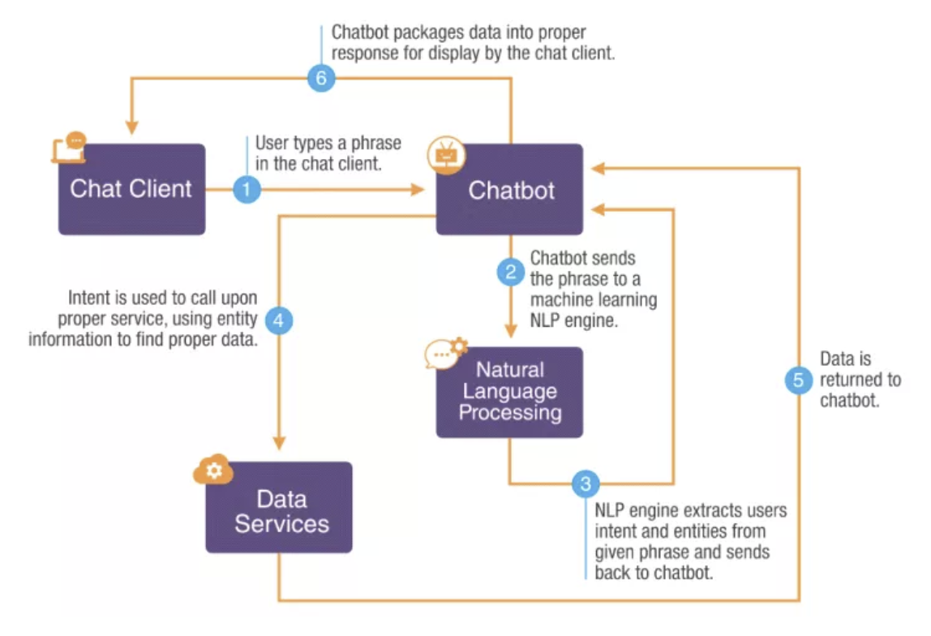
SYSTEM DESIGN

Slide 10
IMPLEMENTATION
TRAINING CODE
%%writefile content.json
{"intents":
[
{
"tag":"greeting",
"input":["hello","hi there","hi","hi, is this opaque shop","hey there","hey"],
"responses":[
"Hi welcome to opaque shop!",
"Hey how can i help you",
"hello dear customer how can i help you",
"hello how can i help you",
"greetings customer how can i help you"
]
},
{
"tag":"shop_details",
"input":["Is this an electronics shop?","Does your shop sell electronics?"],
"responses":[
"Yes,our shop sells electronics",
"Indeed our shop sells electronics"
]
},
{
"tag":"shop_location",
"input":["Where is your shop located?","Could you please tell me the location of your shop?"],
"responses":[
"Vijayanagar",
"Our shop is in Vijayanagar",
"We are located in Vijayanagar"
]
},
{
"tag":"goodbye",
"input":["Thank you, bye","thank you","bye bye","goodbye,thank you"],
"responses":["Thank you customer","bye customer","Thank you customer,hope you have a nice day","goodbye customer"]
}
]
}

Slide 11
IMPLEMENTATION
Tokenization
To dense the multidimensional layer to linear layer
i = Input(shape=(input_shape,))
x = Embedding(vocabulary+1,10)(i)
x = LSTM(10,return_sequences=True)(x)
x = Flatten()(x)
x = Dense(output_length,activation="softmax")(x)
model = Model(i,x)
from tensorflow.keras.preprocessing.text import Tokenizer
tokenizer= Tokenizer(num_words=2000)
tokenizer.fit_on_texts(data['inputs'])
train = tokenizer.texts_to_sequences(data['inputs'])
from tensorflow.keras.preprocessing.sequence import pad_sequences
x_train=pad_sequences(train)
from sklearn.preprocessing import LabelEncoder
le = LabelEncoder()
y_train = le.fit_transform(data['tags'])

Slide 12
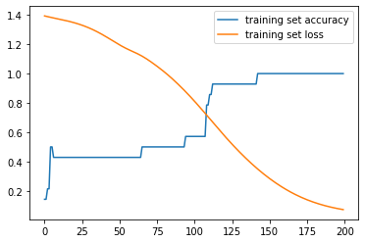
ACCURACY GRAPH
It can also be observed in the accuracy loss graph obtained below:
training set accuracy -determines the accuracy of the tested inputs.
training set loss –determines the loss of accuracy while testing.
.

Slide 13
IMPLEMENTATION
Loop to predict the output based on tags
import random
while True:
texts_p= []
prediction_input= input('You: ')
prediction_input= [letters.lower() for letters in prediction_input if letters not in string.punctuation]
prediction_input= ''.join(prediction_input)
texts_p.append(prediction_input)
prediction_input = tokenizer.texts_to_sequences(texts_p)
prediction_input = np.array(prediction_input).reshape(-1)
prediction_input= pad_sequences([prediction_input],input_shape)
output = model.predict(prediction_input)
output = output.argmax()
response_tag = le.inverse_transform([output])[0]
print("Salesman :",random.choice(responses[response_tag]))
if response_tag == 'goodbye':
break

Slide 14
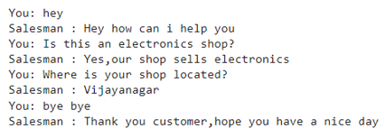
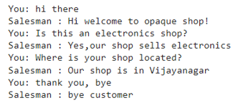
RESULTS
Random outputs for inputs chosen by the salesman bot
Another set of random outputs for inputs.

Slide 15
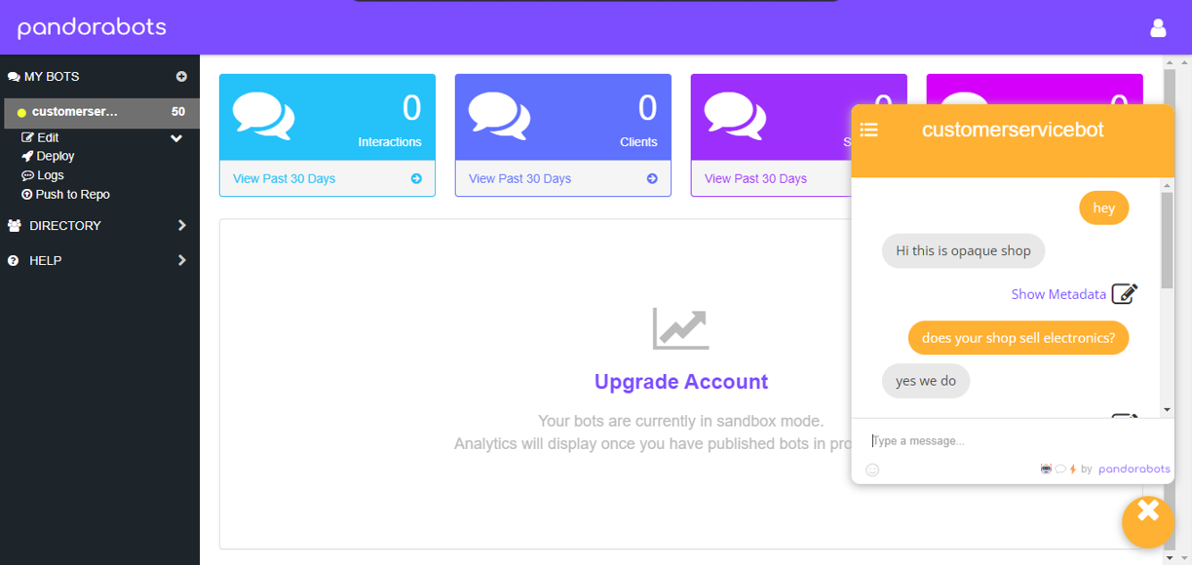
FRONT END SIDE OF THE CHATBOT
The front end side of the CRM chatbot is pandorabot. This is a noteworthy software where a chatbot can be trained
on any number of inputs . This consists of a metadata wherein we can add n number of inputs and outputs to the bot.

Slide 16
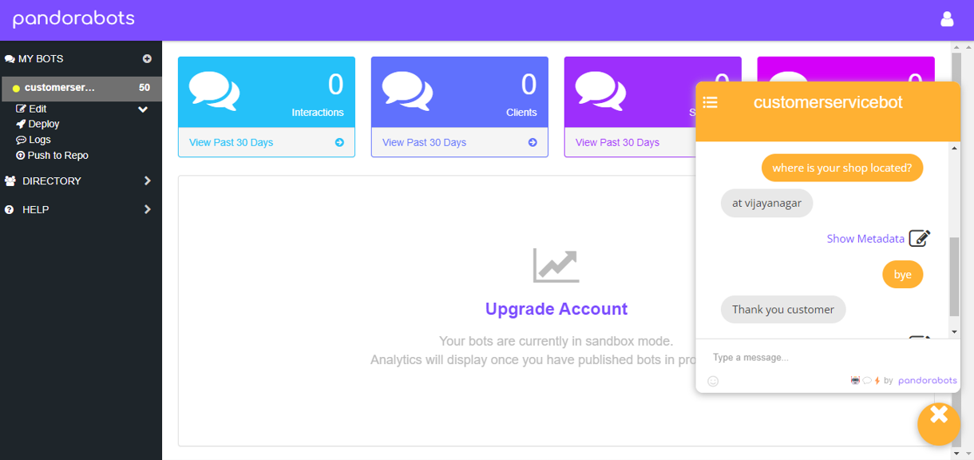

Slide 17
CONCLUSIONS
Tech-savvy consumers of today are always on the lookout for the best and most personalized customer experience.
With a chatbot, your organization can easily offer high-quality support and conflict resolution any time of day, and for a large quantity of customers simultaneously.
The Epoch values are given which predicts the accuracy and loss in the given number of steps. The graph shows the variation of loss as well as accuracy where the loss will be more than accuracy in the beginning but later the graph shows vice-versa variations.
Therefore, more we train the bot more efficient it would be.

Slide 18
LIMITATIONS
Although chatbots use a large database to give appropriate answers, sometimes this is not satisfactory enough.
They lack context awareness, which sometimes can be frustrating for the customers and it can reduce their desire for further communication.
Some people simply prefer human-to-human contact. Although chatbots understand the language we speak, human emotions are a little more complicated to convey.
Creation of a bot requires effort and time, which can be a problem for someone who is just starting to develop their business website.
If there is a misunderstanding between the customer and the chatbot, the conversation can be repeated cyclically, which will lead to neither conversion nor increased sales.

Slide 19
FUTURE ENHANCEMENTS
While most businesses will have chatbots for customer service and support functions, many will develop bots for their internal purposes.
Any customer service tool must be able to scale with the company and its products, work to an increasingly cyclical nature, while operating 24/7 and in multiple languages, as businesses start reaching out globally, and dealing with a growing range of queries.
The technologies may work together to automate mundane activities, freeing up human agents and giving them data-driven insights to help them quickly handle client issues.
Apps like Facebook Messenger, WhatsApp, Slack, and others are digitizing how people interact, and virtually every mode of communication will eventually include AI improvements.

Slide 20
REFERENCES
[1] Accenture. (2016). Chatbots in customer service.
[2] Ayyagari, M.R. (2019). A framework for analytical CRM assessments challenges and recommendations.
[3] Damania, L. (2019). Use Of AI In Customer Relationship Management.
[4] https://www.youtube.com/watch?v=7q5e59BjYAU
[5] https://www.analyticsvidhya.com/blog/2021/10/complete-guide-to-build-your-ai-chatbot-with-nlp-in-python/

Slide 21
Question and Answer

Slide 22
THANK YOU

